Slide 1

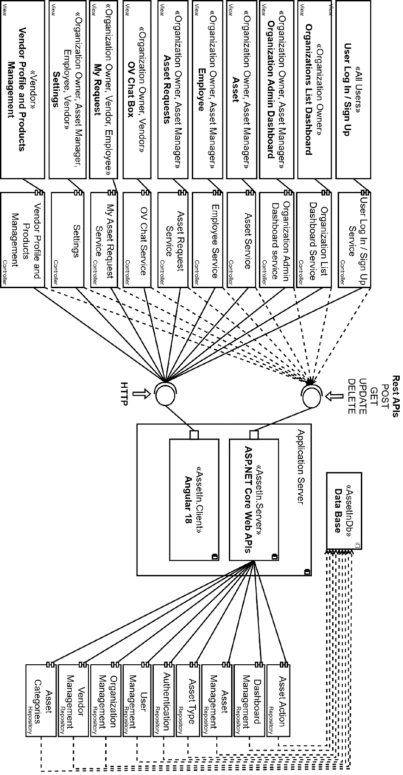
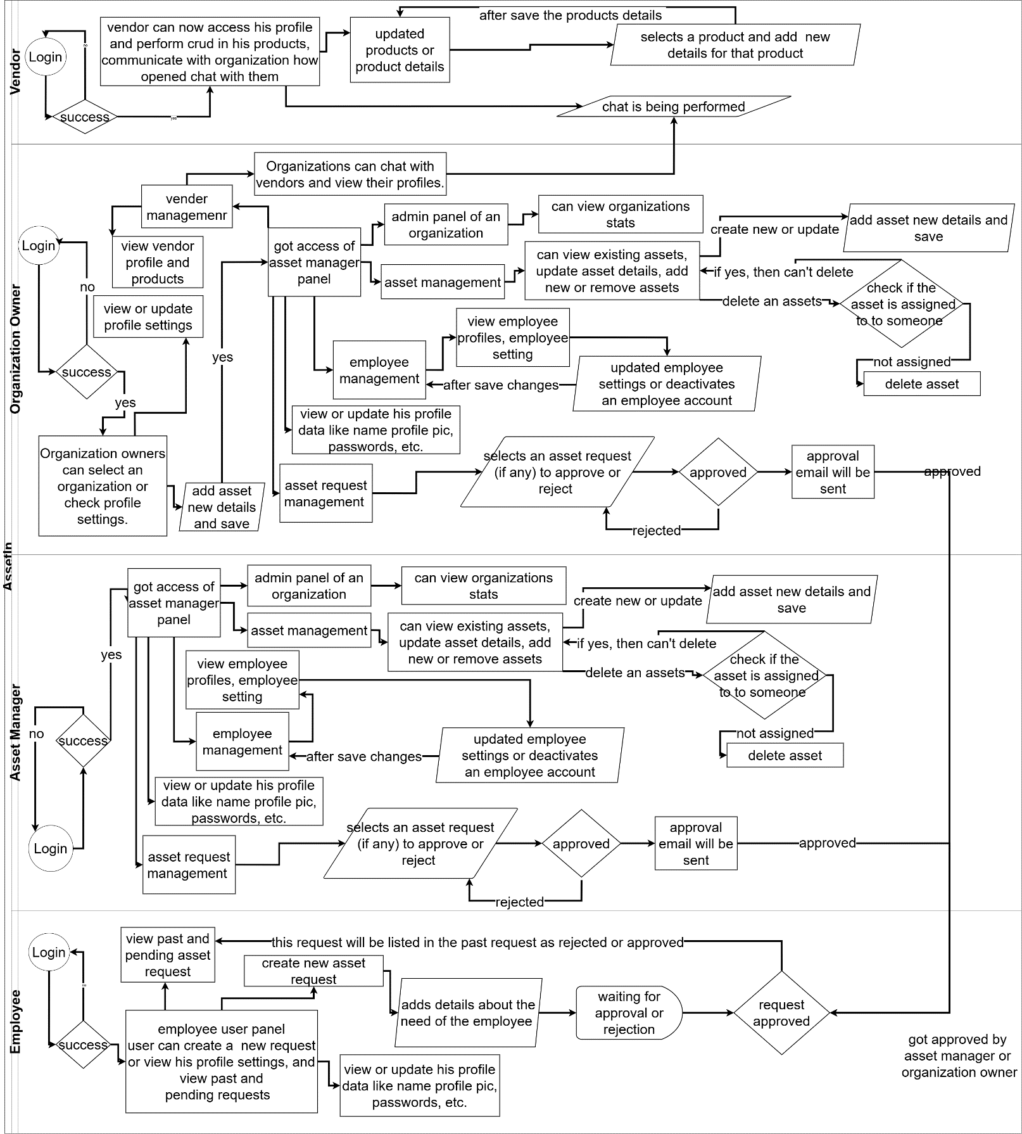
AssetIn: Asset Management Tool
Sir. Asif Farooq
Muhammad Burhan
Areeba Khan
Noor-Ul-Aain Maqbook
F24BS042
Abstract
Asset management plays an important role in organizations to stay operationally efficient but existing tools have fragmented systems, poor usability, and lack of scalability. Such inefficiencies cause cost increment, low utilization of assets, and problematic decision-making processes. Our project, AssetIn aims to address these challenges by introducing an intuitive cloud-based asset management tool that would combine real-time data, vendor management, and predictive analytics.
Leveraging modern technologies such as Angular, .NET, and MySQL, the tool offers a comprehensive solution for tracking both fixed and variable assets, managing vendor relationships, and streamlining maintenance schedules. The tool also incorporates cloud storage for secure and scalable media handling, allowing organizations to store asset-related images, documents, and videos efficiently.
By addressing the shortcomings of existing tools such as Ralph3[1], SnipeIT[2], and Asset Tiger[3], AssetIn is expected to significantly improve asset management workflows. This solution will improve user experience, maximize asset utilization and lower the operational cost for the organizations. Cooperation with Nextonix guarantees the usage of industry standards, and the final product shall be tested in real life to deliver a resilient and viable tool of asset management project.
Introduction
Organizations face growing challenges in asset management due to fragmented workflows, outdated tools, and a lack of real-time insights. AssetIn addresses these issues by offering a unified, cloud-based platform that combines real-time tracking, predictive analytics, and vendor management. Unlike traditional tools such as Ralph, SnipeIT, and Asset Tiger, AssetIn delivers a scalable, user-friendly solution designed to optimize asset usage, reduce costs, and enhance decision-making.
Key features include real-time monitoring, secure media storage, advanced search, predictive maintenance, and role-based access via JWT authentication. Built on a scalable MySQL database, AssetIn empowers organizations of any size to streamline operations, automate workflows, and ensure sustainable asset lifecycle management.
Methods and Materials
Deployment & Infrastructure
Hosted on cloud VPS (Linux), supports HTTPS and JWT-secured APIs
Core Functionalities
Real-time asset tracking, predictive maintenance, barcode scanning
Asset cloning, smart search, and secure file uploads
Email alerts for deadlines, transfers, and maintenance
Technology Stack Frontend: Angular 18 Backend: ASP.NET Core 8 Database: MySQL Authentication: JWT & Identity Framework (RBAC) Cloud Media Storage: Cloudinary API Testing: Postman & Swagger | Architecture & Design Client-server architecture with secure REST communication Angular shared modules and .NET services for maintainability Singleton, Scoped, and Transient service lifecycles based on use.
Figure 1. Component Diagram.
Discussion
Angular 18 used for modular UI and maintainability; Enabled role-based dashboards and reusable components.
ASP.NET Core 8 selected for backend; Provided high performance and secure RESTful API development.
MySQL chosen for structured, normalized asset data; Ensured data integrity and easier reporting.
JWT Authentication implemented; Enabled secure, scalable, role-based access control.
Cloudinary used for media storage; Simplified handling of images, videos, and documents in the cloud.
Repository Pattern adopted in backend; Improved code maintainability and separation of concerns.
Results
Developed a scalable, user-friendly platform for managing assets with role-specific access.
Achieved real-time asset tracking with predictive maintenance and email alerting.
Successfully passed end-to-end testing with no major defects across modules.
Conclusion
AssetIn delivers a smart, scalable solution to modern asset management challenges by integrating real-time tracking, predictive analytics, and vendor coordination into a single cloud-based platform. Through thoughtful design choices and proven technologies, the system enhances efficiency, reduces operational costs, and supports informed decision-making for organizations of all sizes.
Figure 2. Swim Lane.
References
“Ralph3 Documentation,” *Ralph3 Official Site*. [Online]. Available: https://ralph3.readthedocs.io/. [Accessed: 20-Jan-2024].
“Snipe-IT Asset Management,” *Snipe-IT Official Documentation*. [Online]. Available: https://snipe-it.readme.io/. [Accessed: 20-Jan-2024].
“Asset Tiger Review,” *Asset Tiger Blog*. [Online]. Available: https://www.assettiger.com/blog/. [Accessed: 19-Jan-2024].

